Slide 1
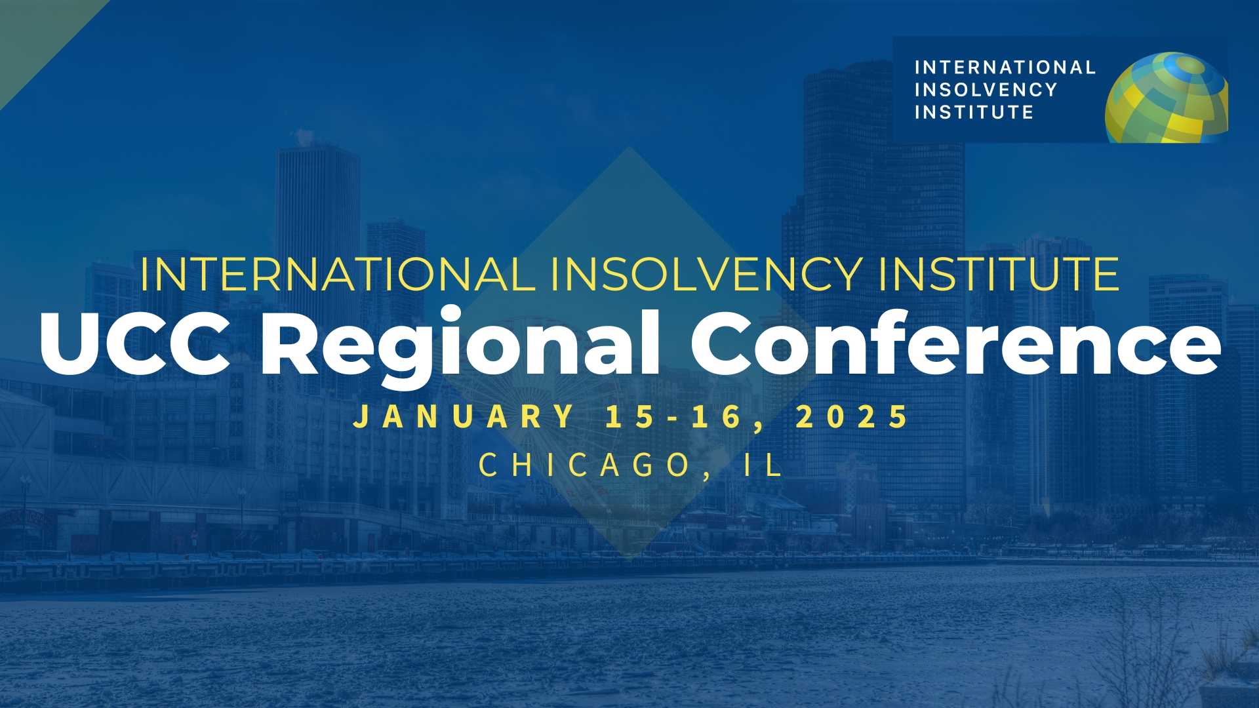

Slide 2

Choosing a restructuring forum in light of Purdue: should US companies restructure abroad?
Moderator: Kathlene Burke – Maples & Calder (Ireland) LLP
Speakers:
Sharon Hamilton – Ernst & Young Inc.
Thomas Kessler – Cleary Gottlieb Steen & Hamilton LLP
Linc Rogers – Blake, Cassels & Graydon LLP
Ruairi Rynn – William Fry LLP
Joshua Sturm – Davis Polk & Wardwell LLP

Slide 3

Are Foreign Courts Accessible to US Companies?
Jurisdiction

Slide 4

Canadian Courts are Accessible to Foreign Companies
To qualify for relief under the Companies’ Creditors Arrangement Act (CCAA), a debtor must:
  Be a Canadian incorporated company or foreign incorporated company with assets in Canada or conducting business in Canada (certain regulated bodies such as banks and insurance companies are not eligible to file under the CCAA but instead may seek relief from creditors under the Winding-up and Restructuring Act).
  Be insolvent or have committed an “act of bankruptcy” within the meaning set out in the Bankruptcy & Insolvency Act (BIA).
  Have in excess of C$5-million in debt or an aggregate in excess of C$5-million in debt if the debtor is part of a filing corporate family.

Slide 5

Irish Courts are Accessible to Foreign Companies
Foreign companies with Irish COMI may access the Irish courts for examinership
Foreign affiliates of Irish companies need only (i) a sufficient connection to Ireland to access examinership and (ii) a reasonable prospect of survival (ideally linked with the survival of the Irish company)
Foreign companies with a “sufficient connection” to Ireland may apply to sanction Part 9 Schemes
COMI
Sufficient Connection
The rebuttable presumption is that a company’s COMI is the location of its registered office (subject to its registered office not being moved to another member state within the previous 3 months)
A company can shift its COMI at any time
Irish courts have followed English precedent and held that shifting one’s COMI for the purpose of accessing the jurisdiction (i.e. forum shopping) is not prohibited
Foreign Company Sufficient Connection
(Part 9
Scheme Only)
Sufficient connection is an easier test to meet than COMI
Irish governing law, assets or operations can create a sufficient connection to Ireland
In Norwegian Air, the Irish court appointed an examiner to the foreign parent with a sufficient connection to Ireland based on the finding that the operations of the group, taken together with the range of legal transactions entered into by the parent and its Irish subsidiaries, were so closely linked and interdependent that the non-Irish parent had a real and deep connection to Ireland
Foreign Company with Irish COMI
Related Company with Sufficient Connection

Slide 6
Jurisdiction - Insolvency Requirements?
  Irish Perspective
    To access Examinership the court must be satisfied that the Company is, or is likely to be, unable to pay its debts. The applicable insolvency tests are very broad and include a cash flow test, a balance sheet test (considering contingent and prospective liabilities), failure to respond to payment demands or to satisfy judgments, or proof ‘to the satisfaction of the court that the company is unable to pay its debts’.
    There is no insolvency requirement to access a Part 9 Scheme of Arrangement.
  Canadian Perspective
    The CCAA does not contain a definition of insolvency. Courts, however, have referenced and applied the definition of insolvency under the BIA. Accordingly, a debtor company will qualify for relief under the CCAA if it is insolvent on a cash-flow basis (i.e., unable to meet its obligations generally as they become due) or on a balance-sheet test (i.e., has liabilities that exceed the value of its assets). Further, the Ontario Superior Court of Justice has held that a debtor may be considered insolvent if the debtor faces a “looming liquidity crisis” or is in the “proximity” of insolvency even if it is currently meeting its obligations as they become due. It is sufficient if the debtor reasonably anticipates that it will become unable to meet its obligations as they come due before the debtor could reasonably be expected to complete a restructuring of its debt.

Slide 7
Jurisdiction - Insolvency Requirements?
  US Perspective
    The U.S. Bankruptcy Code does not have a formal “insolvency requirement,” and solvent companies can file for bankruptcies.
    However, most U.S. courts to examine the question have held that some degree of “financial distress” is required to avoid a dismissal of a bankruptcy filing for lack of good faith.
    This requirement has generally been viewed as modest, but recent cases have shown that courts are willing to dismiss cases where debtors have access to capital and speculative financial liabilities
    E.g., In re LTL Management (“J&J”) (3d Cir.), and In re Aero Tech. (“3M”) (S.D. Ill.)
  Other Countries
    Other countries may have different requirements and an analysis should be done in each jurisdiction to determine whether the US company could file for relief in the foreign jurisdiction

Slide 8

Advantages to Restructuring overseas

Slide 9
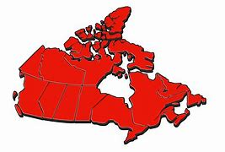
Advantages to Restructuring in Canada
    Cost and Length of Process - Process tends to be shorter and cheaper and participants tend to be much less litigious.
    Reverse Vesting Orders - Instead of a traditional vesting order, if certain criteria are met, a CCAA court also has the authority to issue a “reverse vesting order” or RVO which allows for the transfer of liabilities and/ or unwanted assets out of the debtor company into a newly formed entity (ResidualCo) or existing subsidiary, prior to acquisition of the shares of the existing debtor company by a purchaser.
    Third Party Releases - Courts have held that CCAA plans can provide for releases in favour of third parties (parties other than the CCAA debtor itself and its directors and officers). Third-party releases are available where, among other things, they are necessary and essential to the restructuring of the debtor, the claims to be released are rationally related to the purpose of the plan, the plan could not succeed without the releases and the parties that are the beneficiaries of the releases contribute in a tangible and realistic way to the plan. Releases often purport to bind the applicable creditor as well as its officers, directors, shareholders, affiliates and other parties that may not have received notice of the proceedings. Releases have also been granted in the context of RVOs and traditional vesting orders without the necessity of a vote by creditors.

Slide 10
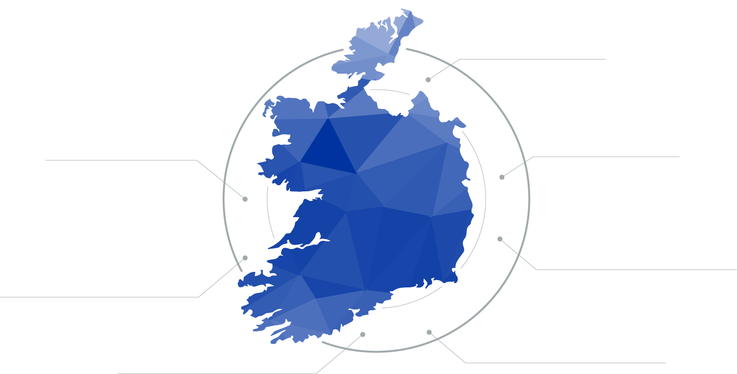
Advantages to Restructuring in Ireland
Irish Examinership / Part 9 Scheme
There are several reasons why Ireland would be the preferred restructuring jurisdiction for a main proceeding or for recognition in the EU
Third Party Releases – Irish courts take a pro-release view with respect to third party releases in Part 9 Schemes and with third party releases potentially available in examinerships
Recognition – Irish procedures are automatically recognised in the EU and can be recognised in the US through a Chapter 15 proceeding and in the UK under 426 of the UK Insolvency Act, the CBIR or a parallel scheme of arrangement
Timing – Irish Examinership schemes must be submitted for confirmation within 100 days and Part 9 Schemes have the option to dispense with the convening hearing if desired
Flexibility – Irish procedures allow significant flexibility in terms of creditor treatment and funding subject to the principal requirement that the outcome for creditors is better than in the most likely alternative scenario
Cross-class cram down – Available through Examinership with the lowest consent threshold in Europe - a bare majority of votes in value and number - along with an automatic stay and other chapter 11-like powers
Cost – Irish proceedings have fewer costs associated with them as there is no automatic statutory unsecured creditors committee and they tend to be less contentious
Less execution risk – Examinerships and Schemes benefit from decades of well-developed common law unlike new European Preventative Restructuring regimes that have only recently been put in place
COMI – Ireland permits COMI shifting allowing a foreign company to establish COMI in Ireland to access its restructuring regime

Slide 11



Irish Examinership – Indicative Timeline
Day 35
Protection Continues
Examiner delivers report to court or applies for extension of reporting period
Day 100 (Max)
Examiner must deliver his report and court fixes date for hearing to confirm proposals and may continue protection
+21 days Max.
Protection ceases
Effective Date: protection is lifted and the proposals are binding on creditors and shareholders
Day 10
Protection Continues
Petition heard – Examiner appointed
Day 1
Protection Starts
for 70 days
Independent Expert's Report and Petition. Application to High Court (ex parte) for directions – Interim Examiner may be appointed
Day 70
Protection Continues
Examiner may apply for a further extension of 30 days to deliver his report and for an extension of the protection period
Day 30
Examiner formulates proposals and convenes meetings of creditors and shareholders to approve proposals
Day 100+
Court hearing to confirm proposals

Slide 12












Successful Irish Examinership Schemes
2022
Irish pharmaceutical company that used an Examinership as a parallel proceeding to implement a US Chapter 11 plan
Restructured $1.3 billion in debt and handed the majority of its reorganised equity to unsecured noteholders
Implemented a 1.7 billion settlement stemming from the opioid crisis and granted third party releases for non-debtors
2021
Norwegian Air is a budget airline that served routes across Europe, North and South America, Southeast Asia and the Middle East before the Covid-19 crisis
Raised NOK 6 billion (€590m) in new capital through public and private placements, reduced debt by approximately NOK 63 billion (€5.5b) through a debt for equity swap having discharged all creditor claims with convertible bonds.
Reduced fleet and operations by terminating aircraft purchase orders and other burdensome contracts

Slide 13

Challenges or potential drawbacks

Slide 14
Potential Drawbacks of Foreign Restructurings
  DIP Lending not as permissive
    In Canada, priming DIP loans are permitted and commonplace. The only major distinction from the US is that in a plenary Canadian proceeding, roll-ups are not permitted
    In Ireland, limited DIP financing options are available with no ability to prime creditor claims secured by fixed charges
  Stay may not be as broad?
    In Canada, this is not generally an issue – There is a stay upon filing which is generally broad and encompasses the same relief as in the US. Given the significant cross-border activity between Canada and the US, it is unlikely that creditors will choose not to respect a Canadian stay when they otherwise would have respected a US stay.
    In Ireland, this is arguably less of an issue too - there is an automatic stay in examinerships that has automatic recognition in the EU and established routes to recognition in the US (Ch 15) and the UK (section 426). However, the stay available in Part 9 Schemes (which provide a clearer route to non-consensual third party releases) is limited to the commencement or progression of legal proceedings and does not prevent enforcement of security.

Slide 15
Potential Drawbacks of Foreign Restructurings
  Creditors less familiar with process
    Canada
      Possible issue vis a vis certain non-North American parties but generally, many U.S. parties are somewhat familiar with the Canadian process and the Canadian process is simple and flexible enough that this is not likely a barrier
    Ireland
      Lack of familiarity with the process can make certain creditors, particularly US based distressed investors or institutions, less comfortable with the process (particularly for a US debtor) when compared to the more familiar Ch 11 process. For example, an independent examiner is appointed in each case and is crucial to the process. However, an Irish examiner is very different than a Ch 11 examiner!

Slide 16


Recognition

Slide 17
Recognition Under Chapter 15
    The consensus among U.S. courts is that U.S.-law governed debt can be compromised in a foreign restructuring (i.e., the U.S. does not have the Gibbs Rule). See, e.g., In re Modern Land (China) Co., 641 B.R. 768 (Bankr. S.D.N.Y. 2022)
    A less clear question is whether a U.S. court can enforce a foreign discharge of U.S. law governed debt in the absence of a Chapter 15 proceeding.
    Some courts have held that longstanding principles of comity allow U.S. courts to recognize the acts of foreign courts, even without a Chapter 15.
    See e.g., Moyal v. Musterland 539 F. Supp. 3d 305 (S.D.N.Y. 2021) (rejecting claim that Chapter 15 proceeding is required to enforce foreign discharge as “absurd”); see also EMA Garp Fund v. Banro Corp., 2019 WL 773988 (S.D.N.Y. 2019) (defendants “under no obligation to file anything in U.S. courts in order to earn [comity] for the Canadian courts”).
    But other courts have taken a narrower view.
    See e.g., Halo Creative v. Comptoir Des Indes, 2018 WL 4742066 (N.D. Ill 2018) (holding that a foreign debtor must receive Chapter 15 recognition to seek relief in a pending civil suit).

Slide 18

Recognition Under Chapter 15
  Recent Objections to third party releases in chapter 15 cases
      The UST objected to the third party releases in Yuzhou based on several grounds
        Exceeds Chapter 15 Authority: The proposed nonconsensual third-party releases expand Chapter 15 beyond the authority provided for post-recognition relief under sections 1507 and 1521.
        Premature and Unnecessary: The Foreign Representative does not require the approval of the U.S. Court to enforce the releases, making the request premature and unnecessary as there is no current case or controversy.
        Contrary to Public Policy: The releases are manifestly contrary to U.S. public policy, as nonconsensual third-party releases are not permissible under U.S. bankruptcy law (Harrington v. Purdue Pharma, L.P., 2024).
        Incomplete Record: The record is incomplete regarding the information presented to creditors and the Hong Kong Court about the releases, making it difficult to assess whether the principles of comity are satisfied under section 1507(b).
        Overly Broad Exculpation: If construed as exculpation, the releases are overly broad and contravene relevant case law, extending beyond what is permissible under U.S. law.
    Are third party releases manifestly contrary to US public policy?
    Let’s assume we can only get the same kind of out-out third party releases you can get in the US? Is there still a benefit to restructuring outside the US even without releases?

